Slide 1
CMSC204
Kartchner
V(StateGraph) = {Oregon, Alaska, Texas, Hawaii, Vermont, NewYork, California}
E(StateGraph) = {(Alaska, Oregon), (Hawaii, Alaska), (Hawaii, Texas), (Texas, Hawaii), (Hawaii, California), (Hawaii, New York), (Texas, Vermont), (Vermont, California), (Vermont, Alaska)}
1. Draw the StateGraph
Oregon
Alaska
New York
Hawaii
Texas
Vermont
California
{Oregon, Alaska, Texas, Hawaii, Vermont, New York, California}
{(Alaska, Oregon), (Hawaii, Alaska), (Hawaii, Texas), (Texas, Hawaii), (Hawaii, California), (Hawaii, New York), (Texas, Vermont), (Vermont, California), (Vermont, Alaska)}
No
Yes
Texas

Slide 2
a. Show the adjacency matrix that would describe the edges in the graph. Store the vertices in alphabetical order
States
0 1 2 3 4 5 6
A
C
H
NY
O
T
V
0
1
2
3
4
5
6
0 0 0 0 1 0 0
1 0 0 0 0 0 0
1 1 0 1 0 1 0
0 0 0 0 1 0 0
0 0 0 0 1 0 0
0 0 1 0 0 0 1
1 1 0 0 1 0 0
3. b. Show the adjacency lists
that would describe the edges in the graph
A
C
H
NY
O
T
V
O
A
C
NY
T
H
V
A
C

Slide 3
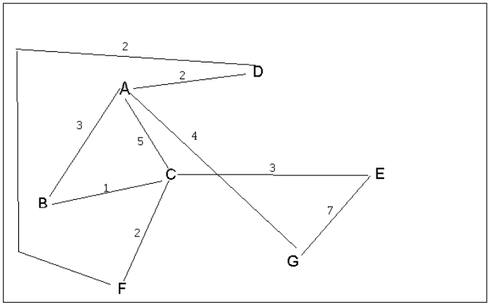
4 a. Which of the following lists the graph nodes in depth first order beginning with E?
A) E, G, F, C, D, B, A
B) G, A, E, C, B, F, D
C) E, G, A, D, F, C, B
D) E, C, F, B, A, D, G
4 b. Which of the following lists the graph nodes in breadth first order beginning at F?
A) F, C, D, A, B, E, G
B) F, D, C, A, B, C, G
C) F, C, D, B, G, A, E
D) a, b, and c are all breadth first traversals

Slide 4
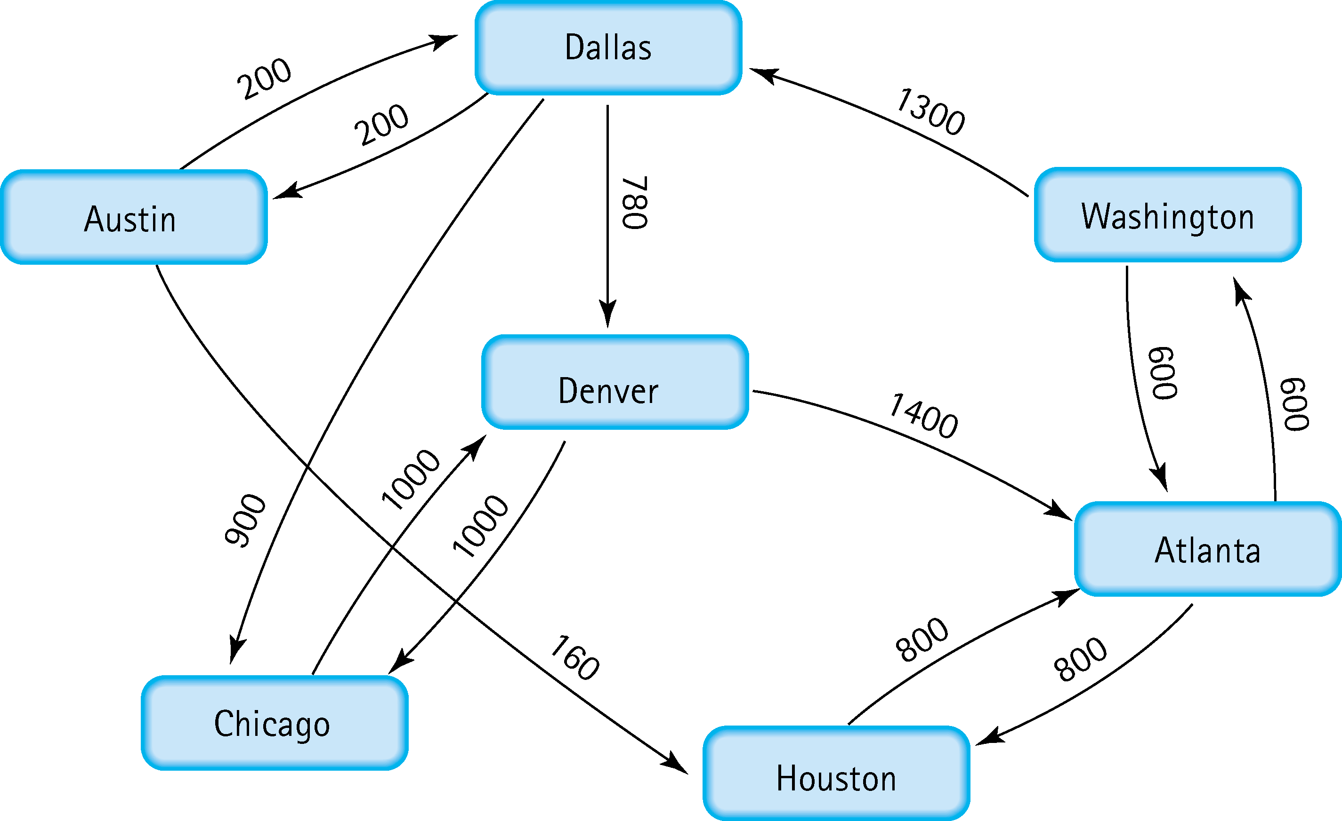
5. Find the shortest distance from Atlanta to every other city
Atlanta → Washington (600)
Atlanta → Houston (800)
Atlanta → Denver (2680)
Atlanta → Dallas (1900)
Atlanta → Chicago (2800)
Atlanta → Austin (2100)

Slide 5
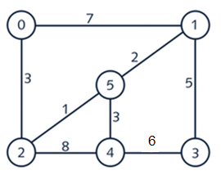
6. Find the minimal spanning tree using Prim’s algorithm. Use
0 as the source vertex . Show the steps.
Add 0 to the Minimum Spanning Tree (MST)
Out of edges 3 and 7, choose the smallest
3 is smaller, so add 2 to MST
Out of edges 1 and 8, choose the smallest
1 is smaller, so add 5 to MST
Out of edges 2,5, and 7, choose the smallest
2 is smaller, so add 1 to MST
Out of edges 7 and 5, choose the smallest
5 is smaller, so add 3 to MST
Out of edges 6 and 3, choose the smallest
3 is smaller, so add 4 to MST

Slide 6
7. Find the minimal spanning tree using Kruskal’s algorithm.
Show the weights in order and the steps.
2 → 5 (1)
1 → 5 (2)
0 → 2 (3)
4 → 5 (3)
1 → 3 (5)
3 → 4 (6)
0 → 1 (7)
2 → 4 (8)

Slide 7
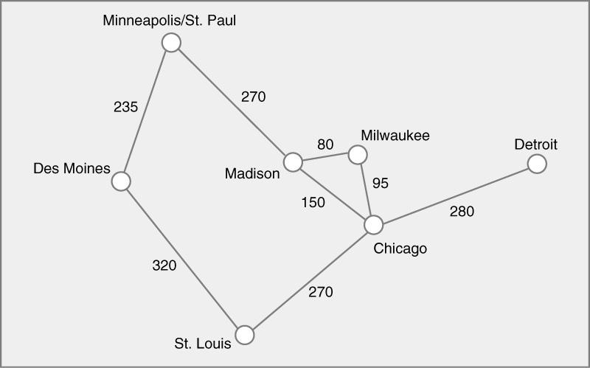




8. Find the minimal spanning tree using the algorithm you prefer. Use
Minneapolis/St. Paul as the source vertex

Slide 8
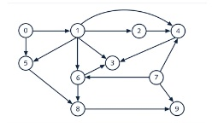

9. List the nodes of the graph in a breadth first topological ordering. Show the
steps using arrays predCount, topologicalOrder and a queue
0 1 2 3 4 5 6 7 8 9
predCount: 0 0 0 0 0 0 0 0 0 0
topologicalOrder: 0 7 1 2 5 6 4 8 3 9
queue: 0 7 1 2 5 6 4 8 3 9

Slide 9
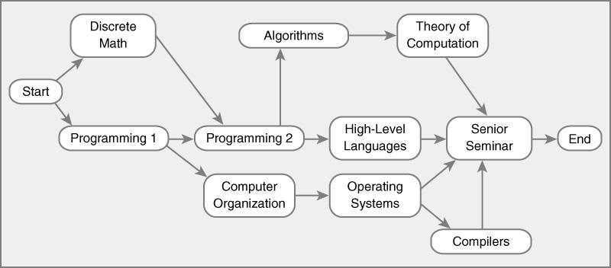
10. List the nodes of the graph in a breadth first topological ordering.
Start → Discrete Math → Programming 1 → Programming 2 → Computer Organization → Algorithms → High-Level Languages → Operating Systems → Theory of Computation → Compiles → Senior Seminar → End

